Slide 1
Catch the deadline
Group Members:
Argert Boja
Bikem Camli
Hareem Larik
Umut Ak
Group 2D

Slide 2
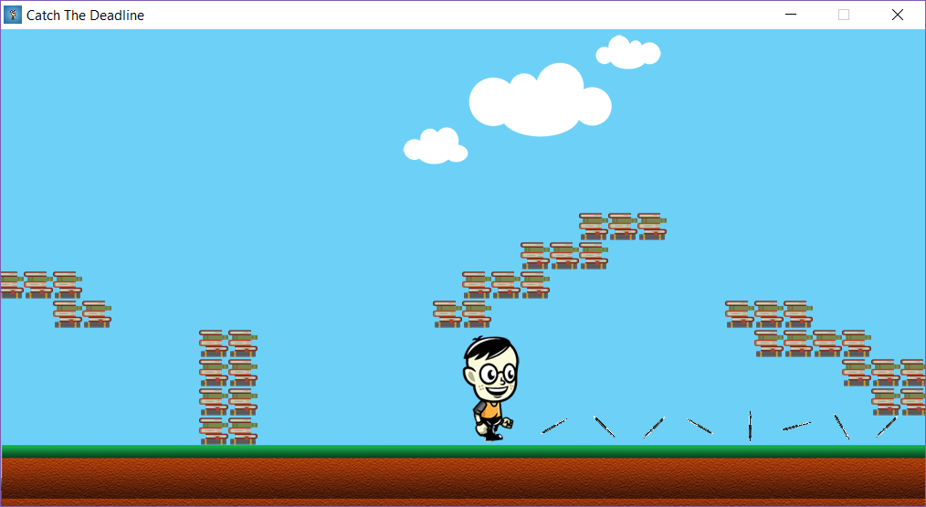
State of development
With respect to coverage of requirements and use cases, the following has been covered:
Navigation through menus(e.g. Main menu, settings, help, credits, high scores)
Player can
Run
Jump
Shoot
Collide with obstacles
Multiple levels have been designed and implemented
(e.g. primary school, high school, university)
At least one type of Game Object has been implemented for each type of game object
Homework ( for Enemy: GameObject )
Pen ( for Weapon: GameObject )
Food ( for PowerUps: GameObject )

Slide 3
Identified problems
New classes that have been added:
Handler (for handling objects events)
BufferedImageLoader (for loading bufferedImages)
SpriteSheet (for getting the subImages from SpriteSheets)
Texture (for loading the subimages from SpriteSheets)
Block (for representing a single block)
ObjectType (enum) (store the type of game objects)
Window (for loading the Jframe and starting the GameEngine)
Classes that have been transferred
All game objects such power ups, weapons, enemies and player etc. have been transferred to a new package ‘GameObjects’
GameEngine has been transferred to a new package ‘Window’
New Classes have been added into the program during prototype implementation, which will lead to changes in the class diagram and detailed system design in Analysis and Design Documentation, respectively.
Some classes have been transferred to a new or a different package for modifiability.
Implementing a local database does not seem to work for now, hence connecting to an online database has been decided.

Slide 4
Lessons about Teamwork
So far each member of the team has contributed fairly and responsibly. Thus, if all members in a team are punctual and responsible, a project can be completed on time with the best results.

Slide 5
Thank You!

